Slide 1

KALDI

Slide 2
Contents
1. Application Operating
2. Application Testing
- Application Problem
- Testing Plan
3. The Progress of Mentoring
4. Milestone

Slide 4
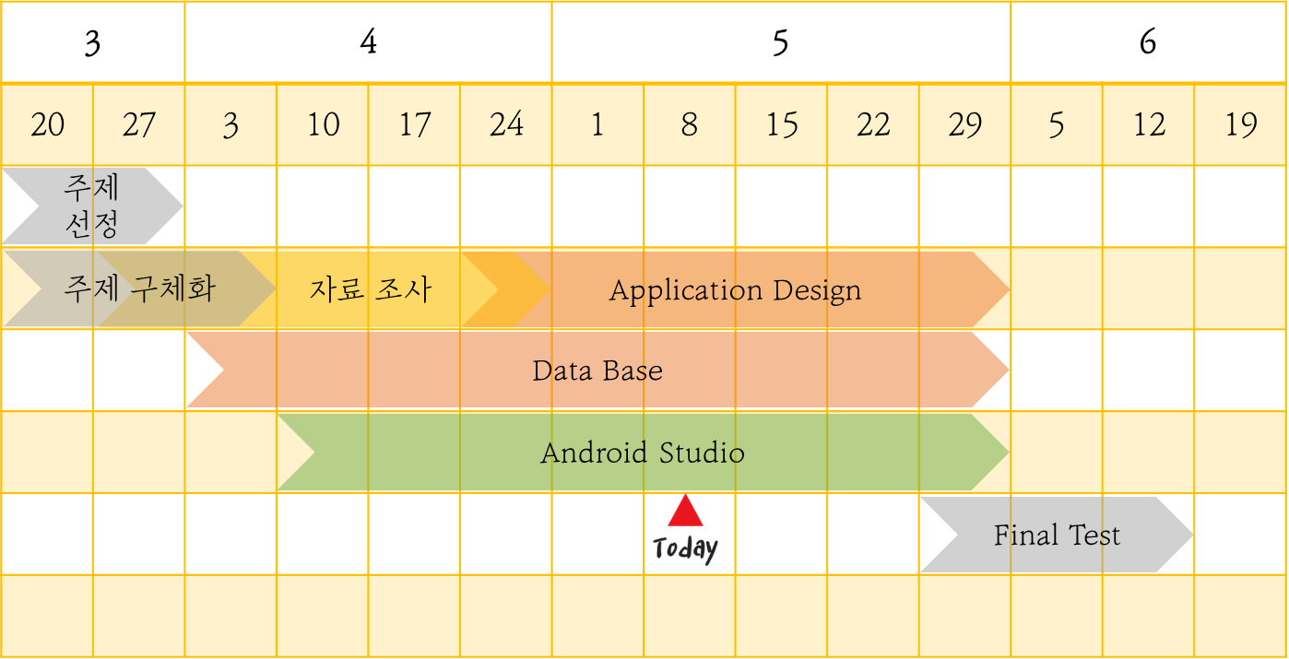
Milestone
KALDI

Slide 5
KALDI
Q & A

